Slide 1
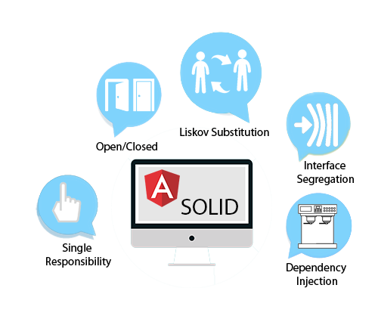
SOLID Principles. RxJS. Services
SoftUni Team
Technical Trainers
Software University
http://softuni.bg

Slide 2
Table of Contents
SOLID Principles
Services
Observables and RxJS
HTTP Client

Slide 3
Have a Question?
sli.do #js-web

Slide 4
S
Single Responsibility
O
Open/Closed
L
Liskov substitution
I
Interface Segregation
D
Dependency Inversion
SOLID Principles

Slide 5
Single Responsibility Principle
A responsibility can be defined as a reason to change
Every class should have only one responsibility
The responsibility should be entirely encapsulated by the class
This principle leads to:
Stronger cohesion and looser coupling
Better readability
Lower complexity

Slide 6
Open-Closed Principle
Software entities like classes, modules and functions should be open for extension, but closed for modification
Open for extension
Adding new behavior doesn't require changes over existing source code
Closed for modification
Changing the source code is not allowed

Slide 7
Liskov Substitution Principle
Derived types must be completely substitutable for their base types
Derived classes
Only extend functionalities of the base class
Must not remove base class behavior

Slide 8
Interface Segregation Principle
Classes that implement interfaces, should not be forced to implement methods they do not use
"Fat" interfaces need to be divided into "role" interfaces (small and more specific)
It is better to have many smaller interfaces, than fewer, fatter ones

Slide 9
Dependency Injection
Dependency is another object that your class needs
Examples (Framework, Database, File System, Providers)
Classes that dependent on each other are called coupled
Dependencies are bad because they decrease reuse
public class Customer {
customerService = new CustomerService('Service');
}
Customer class is dependent on concrete service

Slide 10
Dependency Injection
Dependency Injection is a popular design pattern
Inversion of Control (IoC)
Dependencies are pushed in the class from the outside
The class does not instantiate it's dependencies
public class Customer {
private customerService;
constructor(cService: CustomerService) {
this.customerService = cService;
}
}
The service comes from outside

Slide 11
Classic Violations
Using the new keyword
Using static methods/properties
public class Laptop {
public battery: Battery;
public videoCard: VideoCard;
constructor() {
this.battery = new Battery('Acer battery');
this.videoCard = new VideoCard('Nvidia 960 GTX');
}
}
The class is brittle, inflexible and hard to test

Slide 12
How to fix ?
Add the dependencies through the constructor
Create whatever model you like
constructor(
public videoCard: VideoCard,
public battery: Battery)
let firstLaptop = new Laptop( new VideoCard('Nvidia 940m'), new Battery('Acer Battery'));
let secondLaptop = new Laptop( new VideoCard('Radeon 280x'),
new Battery('Toshiba Battery'));

Slide 13

General Requirements
A class should receive it's dependencies from external sources rather than creating them itself
Decouple dependencies through constructor injection
Your code should be easier to test
Additional information: https://angular.io/guide/dependency-injection-pattern

Slide 14

Services
Constructor Injection, Providers, Injectable

Slide 15
Why we need Services ?
Components shouldn't fetch or save data directly
They should focus on presenting data and delegate data access to a service
Services are a great way to:
Share information among classes that don't know about each other
Avoid code duplication

Slide 16
Create a Service
Services in Angular are just normal TypeScript classes that handle data manipulation:
export class BooksService {
booksData: Book[];
addBook(b: Book) {
this.booksData.push(b);
}
}

Slide 17
Injecting into Components
Services are injected into components via constructor injection
Before that they should be provided from inside the decorator:
@Component({
providers: [ BooksService ]
})
export class BookListComponent {
constructor(
private booksService: BooksService
) { }
}
The same instance will be provided for child components

Slide 18
Injectable Decorator
In order to inject one service into another use the @Injectable decorator:
@Injectable()
export class BooksService {
booksData: Book[];
constructor (
private loggingService: LoggingService
) { }
}
@Injectable({
providedIn: 'root' })
Provided in 'app.module.ts'

Slide 19

Observables and RxJS
Intro to FRP

Slide 20
Functional Programming
Functional Programming is introduced in JS since ES6
Easier array manipulation using (map, filter, reduce, etc.)
Front-end programming is asynchronous
Using a stream to handle asynchronous operations
0, 1, 2, 3, 4
A stream of numeric values

Slide 21
The Observable
In Angular we handle streams using Observables
Create Streams
Subscribe to Streams
React to new values
Combine streams to build new ones
[ 0, 1, 2, 3, 4 ]
Handle a stream as an array

Slide 22

Function Reactive Programming
FRP is a paradigm for software development
Entire programs can be build uniquely around the notion of
streams
Create, combine and subscribe to streams
The core goal of FRP
Build programs in a declarative way
Lack of application state variables

Slide 23
Introducing RxJS
Stands for Reactive Extensions for JavaScript
Install Library
Use with CommonJS
Use with ES6/Angular
npm install rxjs
const { range } = require('rxjs')
const { map, filter } = require('rxjs/operators')
import { range } = 'rxjs'
import { map, filter } = 'rxjs/operators'

Slide 24
Observables Side Effect (Hot vs Cold)
Using the tap operator
Observables are either hot or cold
We need to subscribe to them
const obs = range(1, 10)
.pipe(
tap(i => console.log(`Hello: ${i}`))
);
Has no subscribers (cold)
obs.subscribe(i => console.log(i));
Has a subscriber (hot)

Slide 25
Observables Side Effect (2)
Observables are not shared by default
Creating a subscriber sets up a whole new separate processing chain
Two things to keep in mind:
Is the observable hot or cold?
Is the observable shared or not?
obs.subscribe(i => console.log(`first sub ${i}`));
obs.subscribe(i => console.log(`second sub ${i}`));

Slide 26
Commonly Used RxJS Operators
The map operator
The filter operator
The reduce operator
const obs = range(1, 10).pipe(map(i => i ** 2));
const obs = range(1, 10).pipe(filter(i => i % 2 === 0));
const obs = range(1, 10).pipe(
reduce((prevVal, val) => prevVal + val, 0)
))

Slide 27
RxJS and FRP Overview
RxJS and FRP are really powerful concepts
Multiple choice to structure an Angular app
Go full reactive (extensive use of RxJS)
Via parts (Forms or Http)
More on observables here: Click
More RxJS operators here: Click

Slide 28
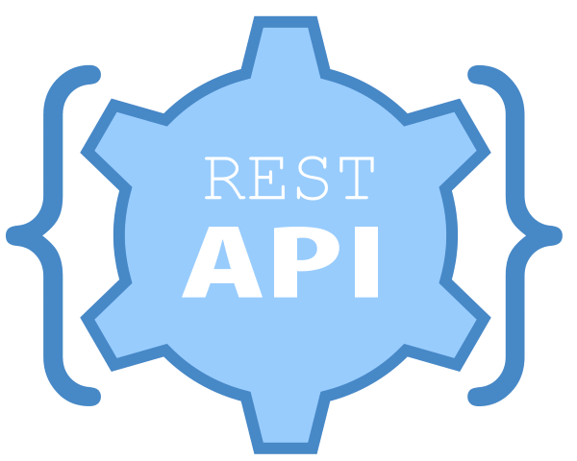
HTTP Client
Fetching data from a remote API

Slide 29
The HTTP Client Module
Before using the HttpClient to fetch data, import the HttpClientModule in "app.module.ts"
Add the module in imports array
import { HttpClientModule } from '@angular/common/http'
@NgModule({
declarations:[ // App Components ],
imports:[
BrowserModule,
HttpClientModule
],
From now on HttpClient can be injected in Services

Slide 30
Using the HTTP Client in Services
Each service should have @Injectable decorator
@Injectable()
export class PostsService { constructor(
private http : HttpClient
) { }
getAllPosts() : Observable<Post[]> {
const url = 'https://jsonplaceholder.typicode.com/posts';
return this.http.get<Post[]>(url);
}
}
Inject the HttpClient and use it as a service
The Client works with generic types

Slide 31
Subscribe to the Observable
Inject a service and subscribe to observables
export class PostsComponent implements OnInit {
posts : Posts[]; constructor(
private postsService : PostsService
) { }
ngOnInit(): void {
this.postsService.getAllPosts()
.subscribe(data => {
this.posts = data;
});
}
}
Always subscribe to observables

Slide 32
Type Checking the Response
It is recommended to cast the response
getAllPosts() : Observable<Post[]> {
const url = 'https://jsonplaceholder.typicode.com/posts';
return this.http.get<Post[]>(url);
}
Should be an interface
interface Post {
userId: number;
id: number;
title: string;
body: string;
}

Slide 33
Catching Errors
To handle errors add an error handler to subscribe call
ngOnInit(): void {
this.postsService.getAllPosts()
.subscribe(
data => { // Attach data to prop },
err => {
console.log(`Something went wrong: ${JSON.stringify(err)}`
)
}
)
}
The error can differ depending on the API

Slide 34
Async Pipe Example
Async pipe takes care of subscribing and unwrapping the data
As well as unsubscribing when the component is destroyed
export class PostsComponent implements OnInit {
$posts: Observable<Post[]>
ngOnInit() {
this.$posts = this.postsService.getAllPosts();
}
}
<div *ngFor="let post of $posts | async">…</div>

Slide 35

Summary
DI is a popular design pattern
Using services in Angular is recommended!
RxJS and FRP are really powerful concepts
Use the HttpClient to fetch data from an API
@Component({
providers: [ UsersService ]
})
this.http.get(url).retry().pipe().subscribe()

Slide 36
https://softuni.bg/courses/angular-2-fundamentals

Slide 37













SoftUni Diamond Partners

Slide 38




SoftUni Organizational Partners

Slide 39
Trainings @ Software University (SoftUni)
Software University – High-Quality Education and Employment Opportunities
softuni.bg
Software University Foundation
http://softuni.foundation/
Software University @ Facebook
facebook.com/SoftwareUniversity
Software University Forums
forum.softuni.bg

Slide 40

License
This course (slides, examples, demos, videos, homework, etc.) is licensed under the "Creative Commons Attribution-NonCommercial-ShareAlike 4.0 International" license

